Slide 1
Cryptographic Hash Functions
Notes:
1

Slide 2
Objectives
To introduce general ideas behind cryptographic hash functions
To discuss the Merkle-Damgard scheme as the basis for iterated hash functions
To discuss structure of MD5 algorithm
To discuss structure of SHA algorithm
Notes:
2

Slide 3
INTRODUCTION
A cryptographic hash function takes a message of arbitrary length and creates a message digest of fixed length.
Was originally proposed to generate input to digital signatures.
Desirable features: preimage resistant, second preimage resistant and collision resistant.
Notes:
3

Slide 4
Iterated Hash Function
All cryptographic hash functions need to create a fixed size digest out of a variable size message.
Creating such a function is best accomplished using concept of iteration.
Instead of using a hash function with variable size input, a function with fixed size input is created and is used a necessary number of times.
Notes:
4

Slide 5
Compression Function
The fixed size input function is referred to as a compression function.
It compresses an n-bit string to create m-bit string where n is normally greater than m.
This scheme is referred to as an Iterated Cryptographic Hash Function.
Notes:
5

Slide 6
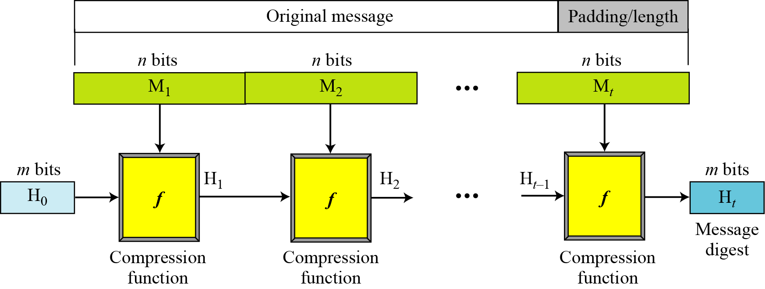
Iterated Hash Function
Merkle-Damgard Scheme : is collision resistant if compression function is collision resistant.
Merkle-Damgard scheme
Notes:
6

Slide 7
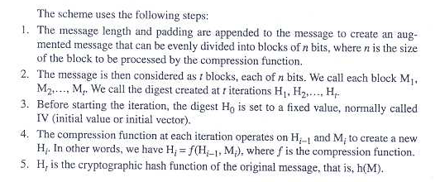
Merkle-Damgard Scheme

Slide 8
Two Groups of Compression Functions
The compression function is made from scratch.
A symmetric-key block cipher serves as a compression function.
Notes:
8

Slide 9
Hash Functions made from scratch
Message Digest (MD)
Message digest (MD) referred as MD2, MD4 and MD5 were designed by Ron Rivest.
MD5 is strengthened version.
2. Secure Hash Algorithm (SHA)
Is a standard that was developed by NIST and published in FIPS 180.
It is sometimes referred to as SHS, mostly based on MD5

Slide 10
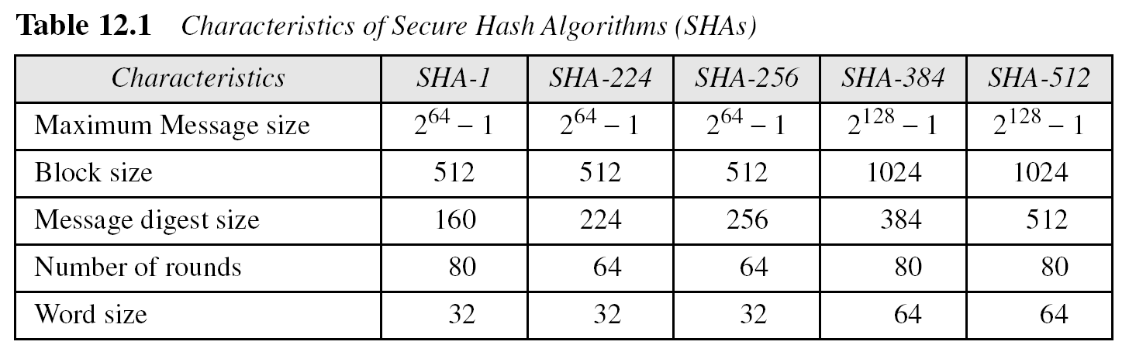
SHA
SHA was revised in 1995 under FIPS 180-1, which includes SHA-1. It was later revised under FIPS 180-2, which defines 4 versions as follows:
** All these versions have the same structure
Notes:
10

Slide 11
Other Algorithms
RACE Integrity Primitive Evaluation Message Digest (RIPEMD) has several versions.
RIPEMD-160 is hash algorithm with 160 bit digest. Same structure as MD5 but uses two parallel lines of execution.
HAVAL is a variable length hashing algorithm with digest of size 128,160,192,224 and 256. Block size is 1024 bits.
RACE : Research and Development in Advanced Communications Technologies in Europe
_{HAVAL: Hash of Variable Length}
Notes:
11

Slide 12
Hash Functions based on Block Ciphers
Instead of creating new compression function, symmetric block ciphers can be used as compression function.
Several schemes are proposed.

Slide 13
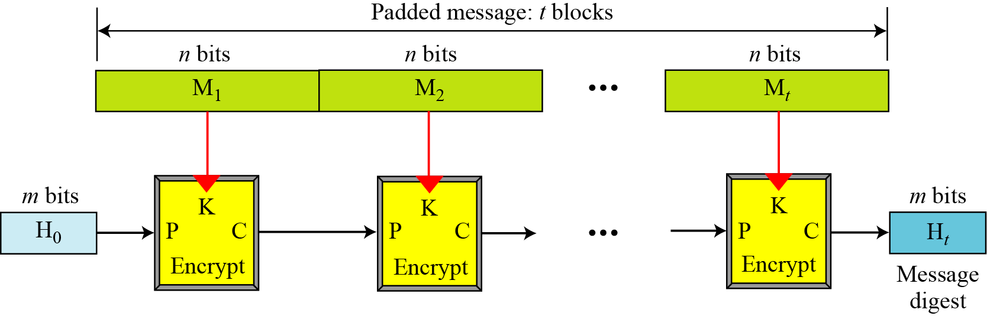
Rabin Scheme
Notes:
13

Slide 14
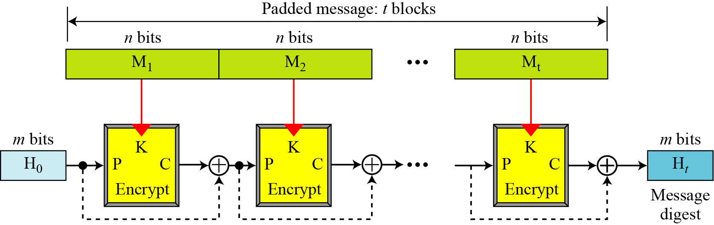
Davies-Meyer Scheme
Notes:
14

Slide 15
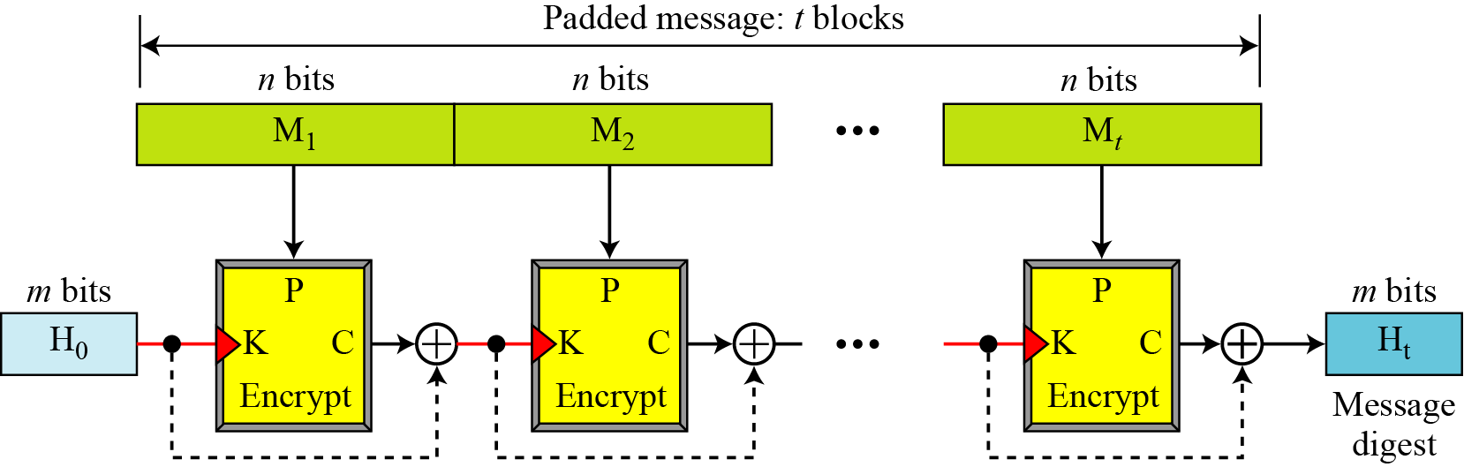
Matyas-Meyer-Oseas Scheme
Notes:
15

Slide 16
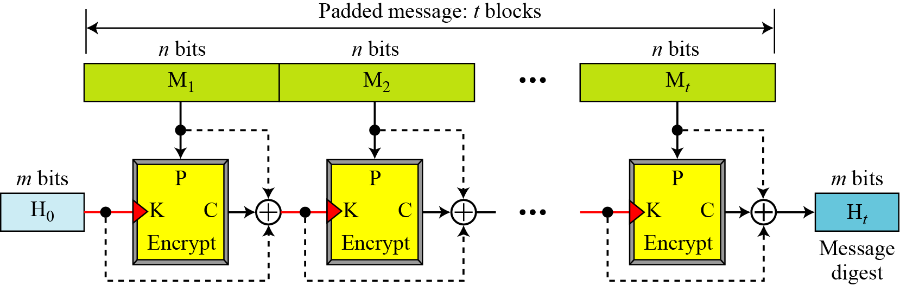
Miyaguchi-Preneel Scheme
Notes:
16

Slide 17
MD5
MD5 algorithm was developed by Professor Ronald L. Rivest in 1991.
According to RFC 1321, “MD5 message-digest algorithm takes as input a message of arbitrary length and produces as output a 128-bit "fingerprint" or "message digest" of the input.
The MD5 algorithm is intended for digital signature applications, where a large file must be "compressed" in a secure manner before being encrypted with a private (secret) key under a public-key cryptosystem such as RSA.”

Slide 18
Steps in MD5
Append padding bits
Append length
Initialize MD buffer
Process message in 16-word blocks
Output

Slide 19
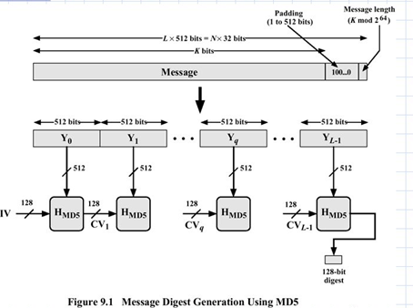
_{MD5}

Slide 20
Step 1: append padding bits
The message is "padded" (extended) so that its length (in bits) is congruent to 448, modulo 512. That is, the message is extended so that it is just 64 bits shy of being a multiple of 512 bits long.
Padding is performed as follows: a single "1" bit is appended to the message, and then "0" bits are appended so that the length in bits of the padded message becomes congruent to 448, modulo 512.

Slide 21
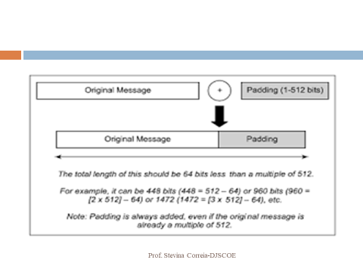

Slide 22
Step 2: append length
A 64-bit representation of b (the length of the message before the padding bits were added) is appended to the result of the previous step.

Slide 23
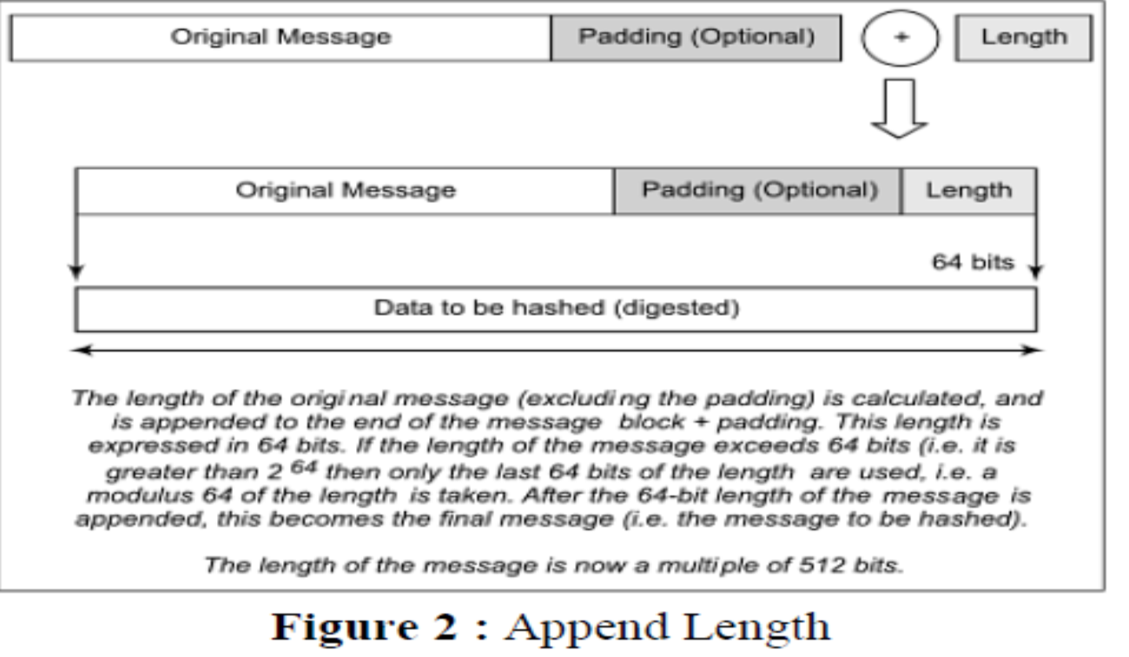

Slide 24
After Step 1 and Step 2
Preparing the input
each block (512 bits) is divided into 16 words of 32 bits each.
These are denoted as M₀ ... M₁₅

Slide 25
Step 3: Initialize MD buffer
MD5 uses a buffer that is made up of four words that are each 32 bits long. These words are called A, B, C and D. They are initialized as:
word A: 01 23 45 67
word B: 89 ab cd ef
word C: fe dc ba 98
word D: 76 54 32 10

Slide 26
Step 4: process message in 16 words block
We first define four auxiliary functions for four rounds that each take as input three 32-bit words and produce as output one 32-bit word.
F(X,Y,Z) = (X and Y) or (not(X) and Z) G(X,Y,Z) = (X and Z) or (Y and not(Z)) H(X,Y,Z) = X xor Y xor Z
I(X,Y,Z) = Y xor (X or not(Z))
They apply the logical operators and, or, not and xor to the input bits.

Slide 27
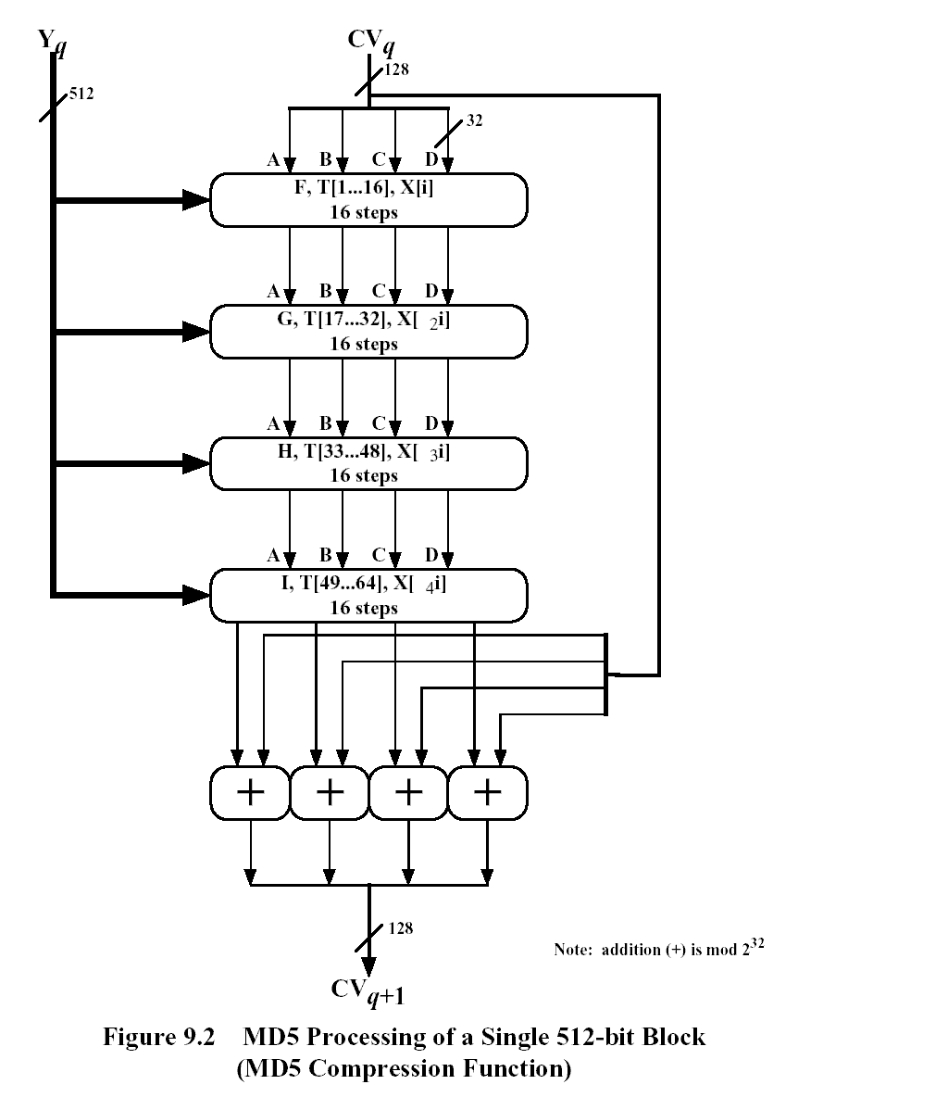

Slide 28
MD5 Compression Function
each round has 16 steps of the form:
a = b+((a+g(b,c,d)+X[k]+T[i])<<<s)
a,b,c,d refer to the 4 words of the buffer, but used in varying permutations
note this updates 1 word only of the buffer
after 16 steps each word is updated 4 times
₂₈
Notes:
28
Each round mixes the buffer input with the next "word" of the message in a complex, non-linear manner. A different non-linear function is used in each of the 4 rounds (but the same function for all 16 steps in a round). The 4 buffer words (a,b,c,d) are rotated from step to step so all are used and updated. g is one of the primitive functions F,G,H,I for the 4 rounds respectively. X[k] is the kth 32-bit word in the current message block. T[i] is the ith entry in the matrix of constants T. The addition of varying constants T and the use of different shifts helps ensure it is extremely difficult to compute collisions.

Slide 29
Continued...
where g(b,c,d) is a different nonlinear function in each round (F,G,H,I)
X[k] is the kth 32-bit word in the current message block
T[i] denote the i-th element of the table. T[1 ... 64] constructed from the sin function, which is equal to the integer part of 4294967296 times abs(sin(i)), where i is in radians.
The item "<<<s" denotes a binary left shift by s bits
₂₉
Notes:
29
Each round mixes the buffer input with the next "word" of the message in a complex, non-linear manner. A different non-linear function is used in each of the 4 rounds (but the same function for all 16 steps in a round). The 4 buffer words (a,b,c,d) are rotated from step to step so all are used and updated. g is one of the primitive functions F,G,H,I for the 4 rounds respectively. X[k] is the kth 32-bit word in the current message block. T[i] is the ith entry in the matrix of constants T. The addition of varying constants T and the use of different shifts helps ensure it is extremely difficult to compute collisions.

Slide 30
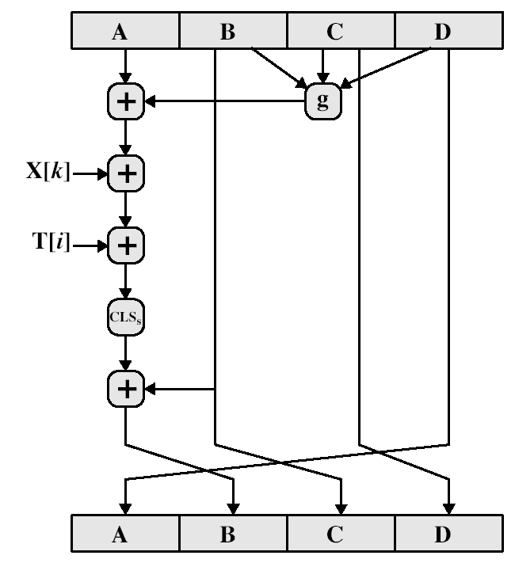
Continued...
a = b+((a+g(b,c,d)+X[k]+T[i])<<<s)
₃₀
Notes:
30
Stallings Fig 12-3.

Slide 31
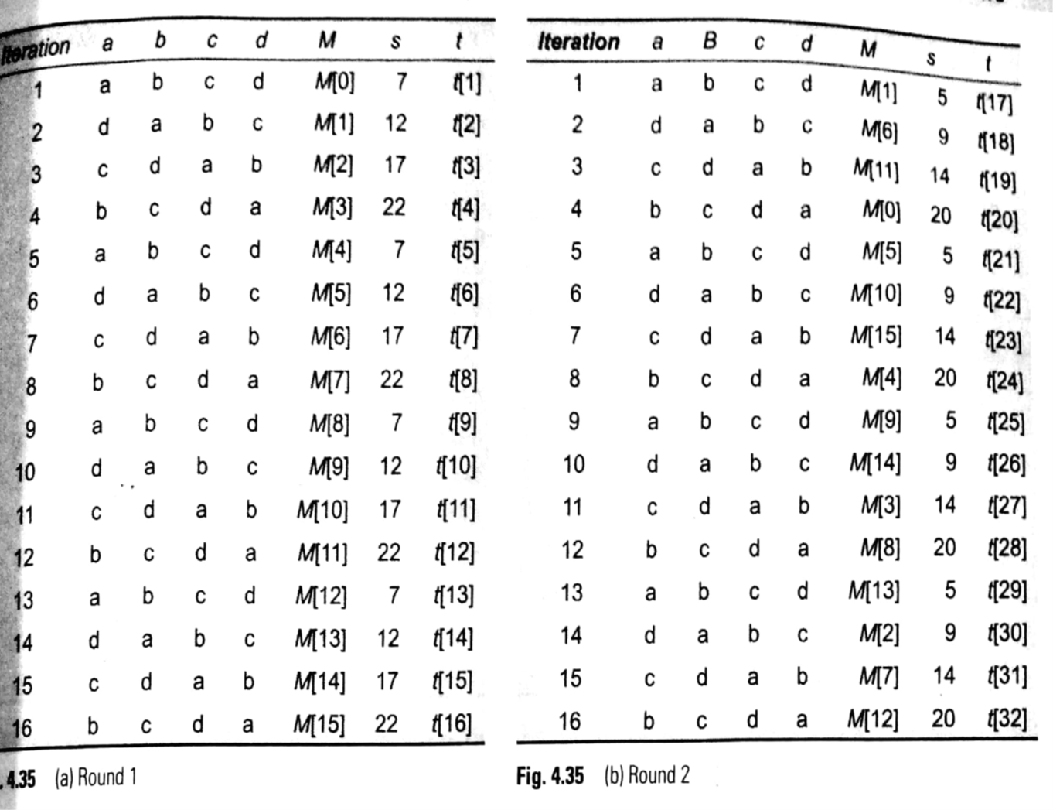
₃₁

Slide 32
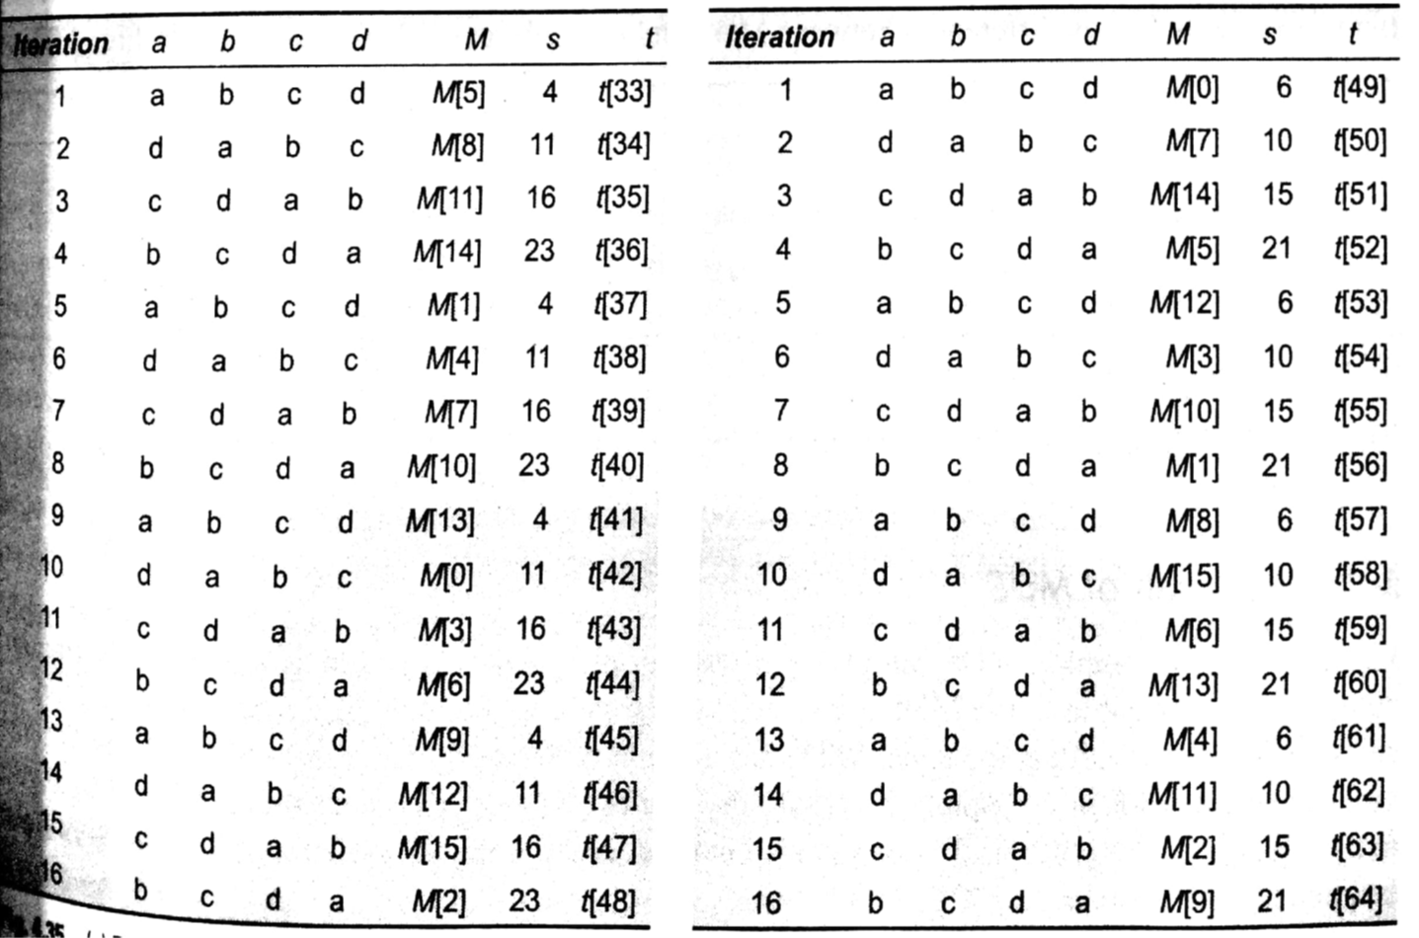

Slide 33
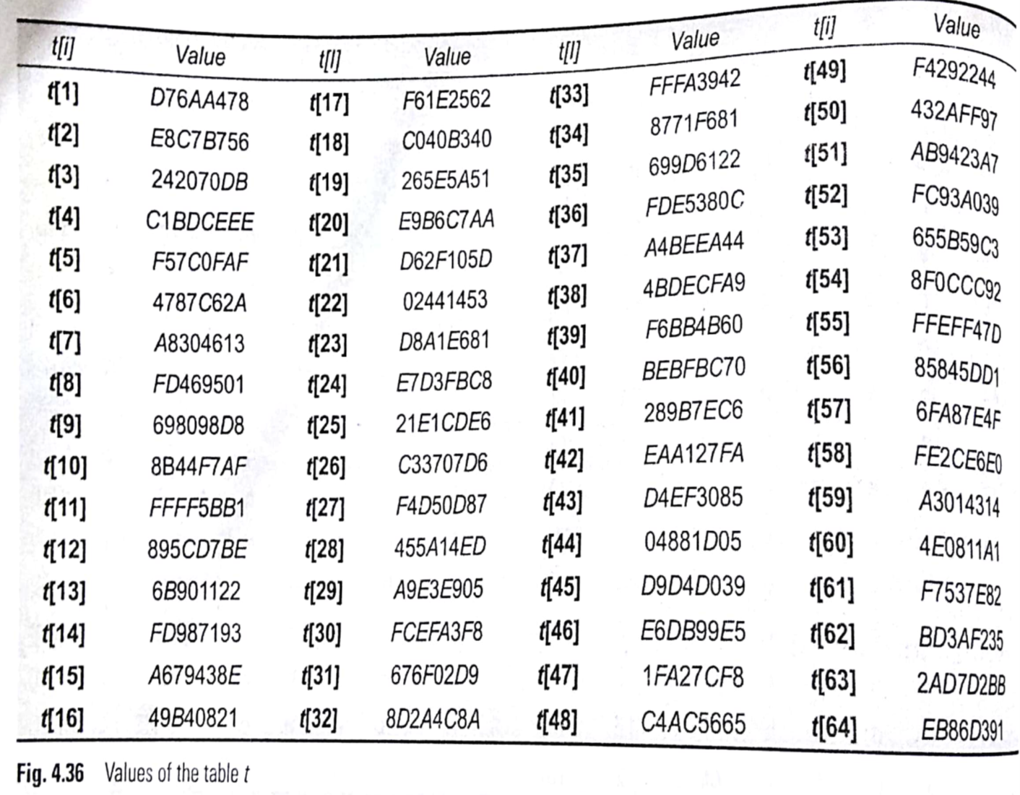

Slide 34
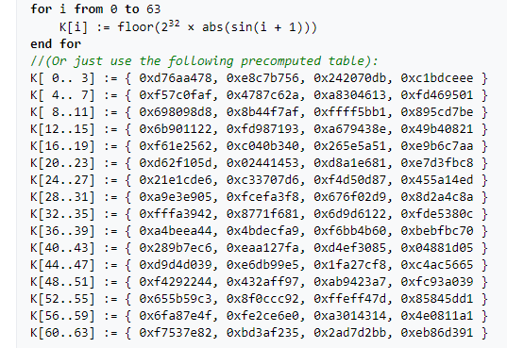
T[i]
₃₄
Notes:
34

Slide 35
Step 5: Output
After all rounds have been performed, the buffers A, B, C and D contain the MD5 digest of the original input.
₃₅

Slide 36
MD4
precursor to MD5
also produces a 128-bit hash of message
has 3 rounds of 16 steps versus 4 in MD5
design goals:
collision resistant (hard to find collisions)
fast, simple, compact
₃₆
Notes:
36
MD4 is the precursor to MD5, and was widely used. It uses 3 instead of 4 rounds, and the round functions are a little simpler. In creating MD5 Rivest aimed to strengthen the algorithms by introducing the extra round, and varying the constants used.

Slide 37
MD5 vs. MD4
A fourth round has been added.
Each step has a unique additive constant.
The function g in round 2 was changed from (XY v XZ v YZ) to (XZ v Y not(Z)).
Each step adds in the result of the previous step.
The order in which input words are accessed in rounds 2 and 3 is changed.
The shift amounts in each round have been optimized. The shifts in different rounds are distinct.
Notes:
MD5 is slower than MD4
37

Slide 38
Summary
Comparing to other digest algorithms, MD5 is simple to implement, and provides a "fingerprint" or message digest of a message of arbitrary length.
It performs very fast on 32-bit machine.
MD5 is being used heavily from large corporations, such as IBM, Cisco Systems, to individual programmers.
MD5 is considered one of the most efficient algorithms currently available.

Slide 39
Secure Hash Algorithm (SHA-1)
SHA was designed by NIST in 1993, revised 1995 as SHA-1
The algorithm is SHA, the standard is SHS
produces 160-bit hash values
now the generally preferred hash algorithm
based on design of MD4 with key differences
₃₉
Notes:
39
SHA is one of the newer generation of hash functions, more resistant to cryptanalysis, and now probably preferred for new applications.

Slide 40
Characteristics of SHA algorithms
₄₀

Slide 41
Steps in SHA
Append padding bits
Append length
Initialize MD buffer
Process message in 16-word blocks
Output

Slide 42
SHA-1 Overview
Step 1: Pad message so its length is 448 mod 512
Step 2: Append a 64-bit length value to message
Step 3: Initialise 5-word (160-bit) buffer (A,B,C,D,E)
Step 4: Process message in 16-word (512-bit) chunks:
expand 16 words into 80 words by mixing & shifting
add output to input buffer to form new buffer value
Step 5: Output hash value is the final buffer value
₄₂
Notes:
42
Note that the SHA-1 Overview is very similar to that of MD5.

Slide 43
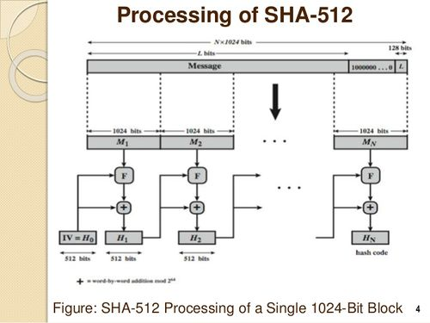

Slide 44
SHA-1 Compression Function
each round replaces the 5 buffer words thus:
(A,B,C,D,E) <-(E+f(t,B,C,D)+(A<<5)+W_{t}+K_{t}),A,(B<<30),C,D)
a,b,c,d,e refer to the 5 words of the buffer
t is the step number
f(t,B,C,D) is nonlinear function for round
W_{t} is derived from the message block
K_{t} is a constant value derived from sin function
₄₄
Notes:
44
.

Slide 45
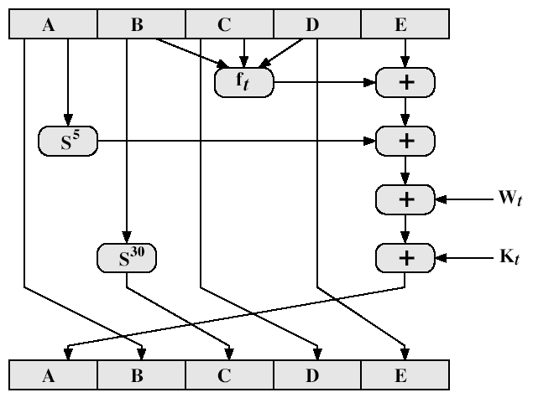
SHA-1 Compression Function
₄₅
Notes:
45
Stallings Fig 12-6.

Slide 46
SHA-1 verses MD5
brute force attack is harder (160 vs 128 bits for MD5)
not vulnerable to any known attacks (compared to MD4/5)
a little slower than MD5
both designed as simple and compact
₄₆
Notes:
46
Compare using the design goals listed earlier.
SHA-1 is probably the preferred hash function for new applications. Currently no problems are known with it.

Slide 47
Revised Secure Hash Standard
NIST has issued a revision FIPS 180-2
adds additional hash algorithms
SHA-224, SHA-256, SHA-384, SHA-512
designed for compatibility with increased security provided by the AES cipher
structure & detail is similar to SHA-1
hence analysis should be similar
₄₇
Notes:
47
See Stallings Tables 12.3 and 12.4 for details.

Slide 48
SHA-512
SHA-512 is the version of SHA with a 512-bit message digest.
This version, like the others in the SHA family of algorithms, is based on the Merkle-Damgard scheme.
Notes:
48

Slide 49
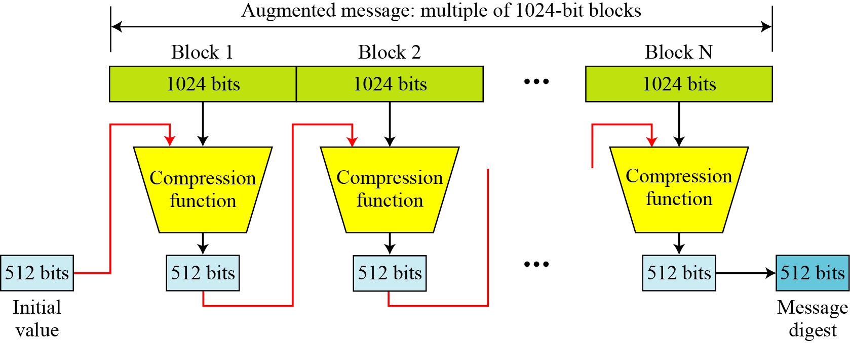
Introduction
Figure Message digest creation SHA-512
Notes:
49

Slide 50
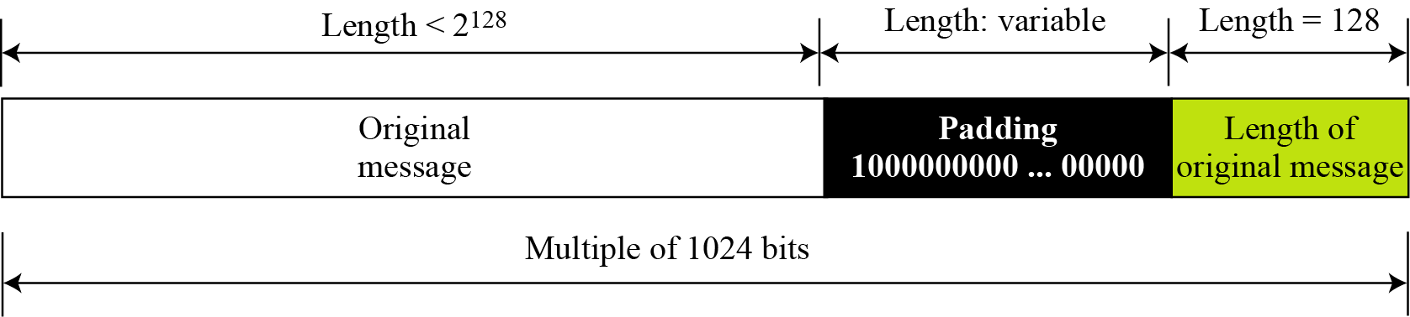
Step 1&2: Padding and append length
Figure Padding and length field in SHA-512
Message Preparation
SHA-512 insists that the length of the original message be less than 2¹²⁸ bits.
Notes:
50

Slide 51
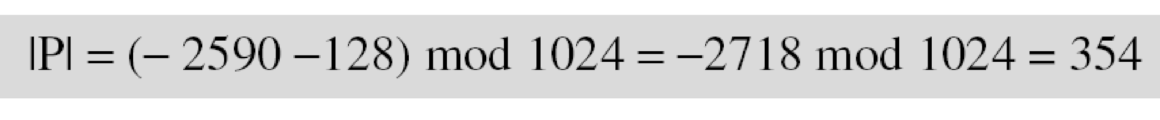
Continued
Example
What is the number of padding bits if the length of the original message is 2590 bits?
Solution
We can calculate the number of padding bits as follows:
The padding consists of one 1 followed by 353 0’s.
Notes:
51

Slide 52
Step 3: Initialize MD buffer
SHA-512is word oriented. Word is defined as 64 bits.
Each block of message consists of 16 64-bit words.
Message digest is also made of 64-bit words and hence message digest is 8 words (8*64=512 bits).
8 words named as A,B,C,D,E,G,H

Slide 53
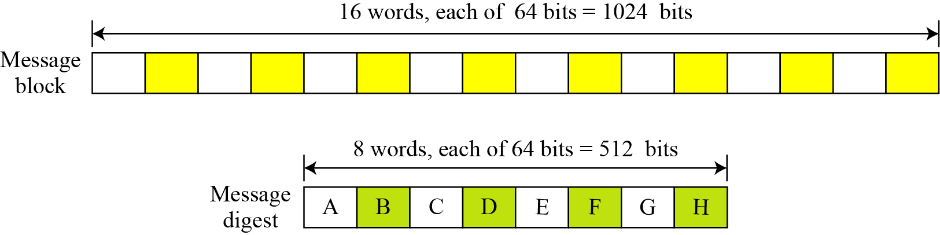
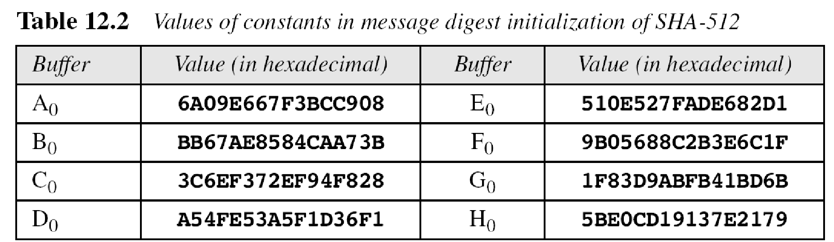
Step 3: Initialize MD buffer
A message block and the digest as words
Notes:
53

Slide 54
Word Expansion
Before processing, each message block must be expanded.
Each block is made of 16 words of 64 bits each.(1024 bits)
In the next step i.e. processing step, we need 80 words.
So 16 word block need to be expanded to 80 words, from W₀ to W₇₉.

Slide 55
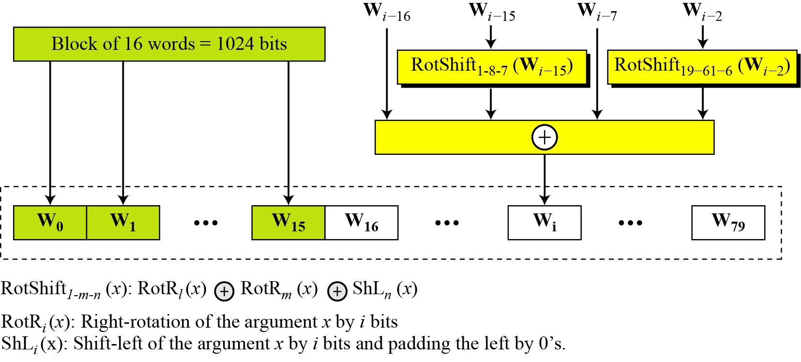
Word Expansion
Figure Word expansion in SHA-512
Notes:
55

Slide 56

Example
Show how W60 is made.
Solution
Each word in the range W16 to W79 is made from four previously-made words. W60 is made as
Notes:
56

Slide 57
Step 4: Process message
Processing of each block of data (1024 bits) in SHA-512 involves 80 rounds.
In each round, contents of eight previous buffers, one word from expanded block (W_{i}), and one 64 bit constant (K_{i}) are mixed together and then operated on to create a new set of eight buffers.
At the beginning, values of 8 buffers are saved into temporary variables and at the end of processing, these values are added to the values created from last round. This last operation is Final adding

Slide 58
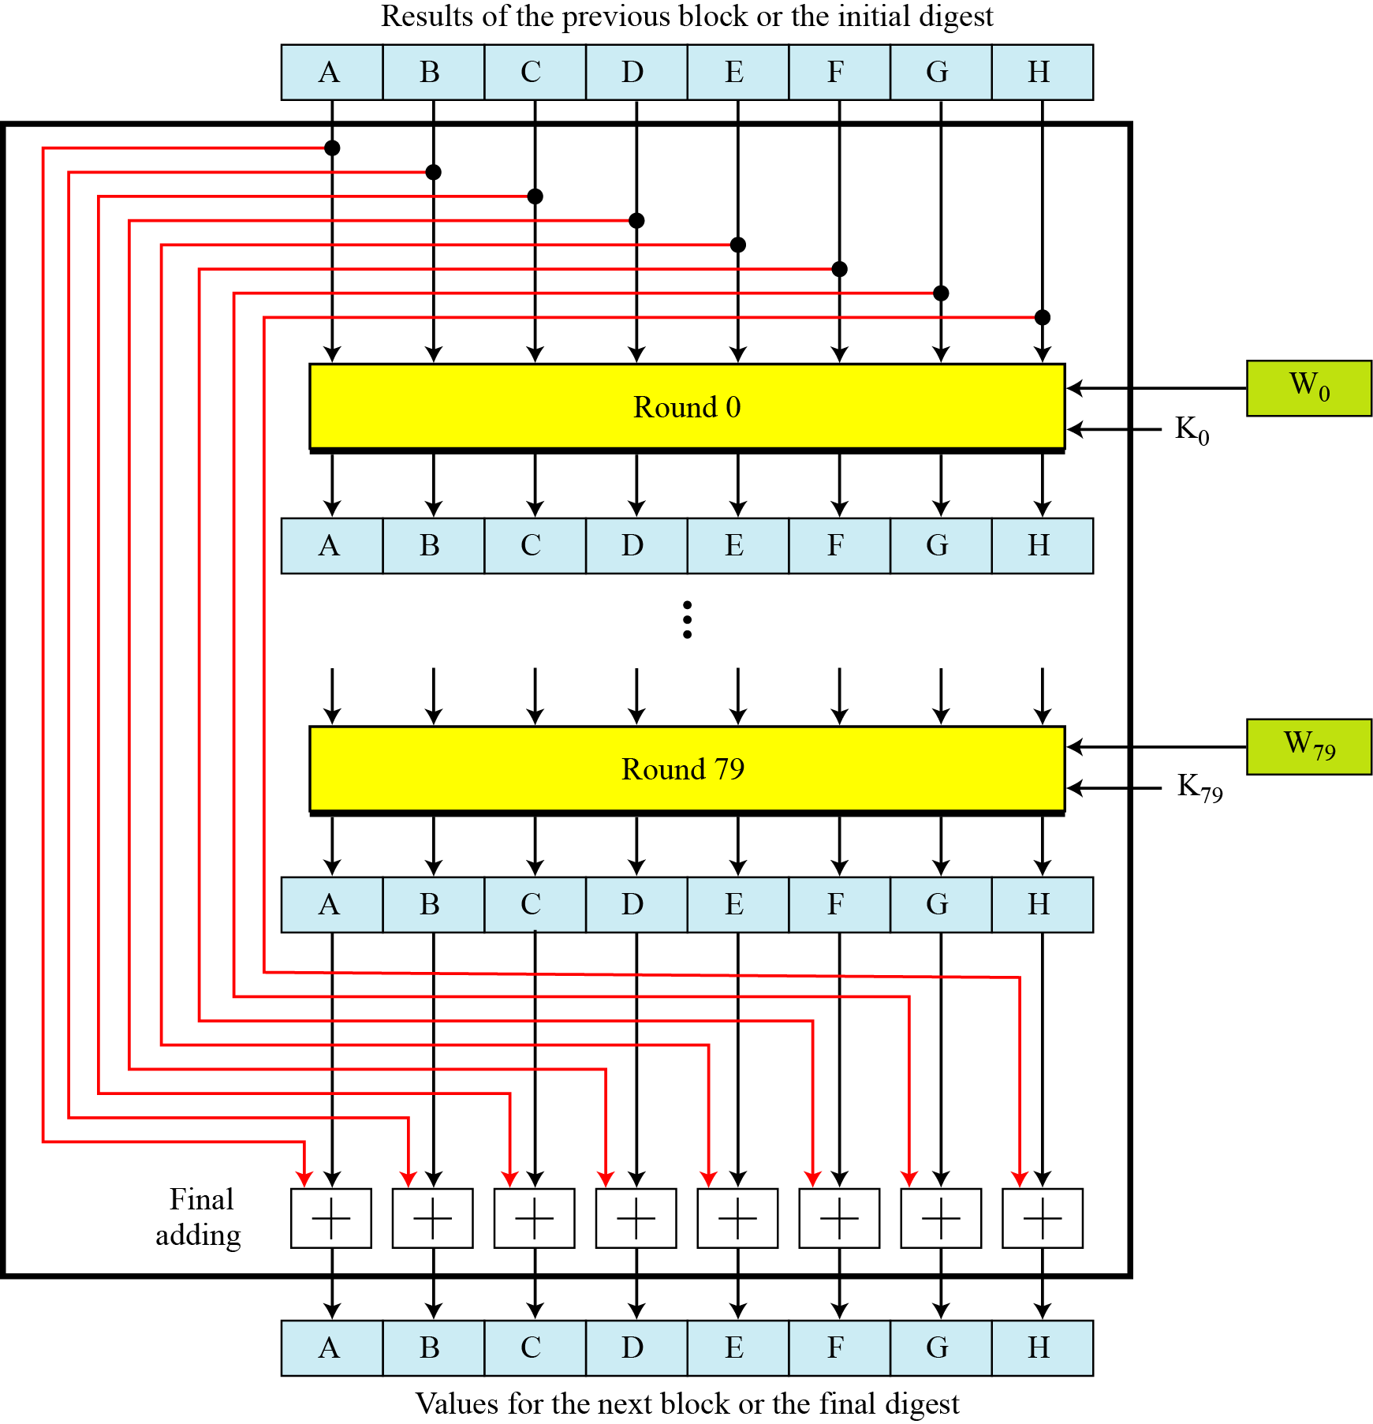
Compression Function
Notes:
58

Slide 59
Structure of each round
In each round, eight new values are for 64-bit buffers are created from the values of the buffers in previous round.
Six buffers (B,C,D,F,G,H) are exact copies of one of the buffers in previous round.
Two of the new buffers, A and E, receive their inputs from some complex functions that involve some of the previous buffers, W_{i} and K_{i}.
There are two mixers, three functions, and several operators.

Slide 60
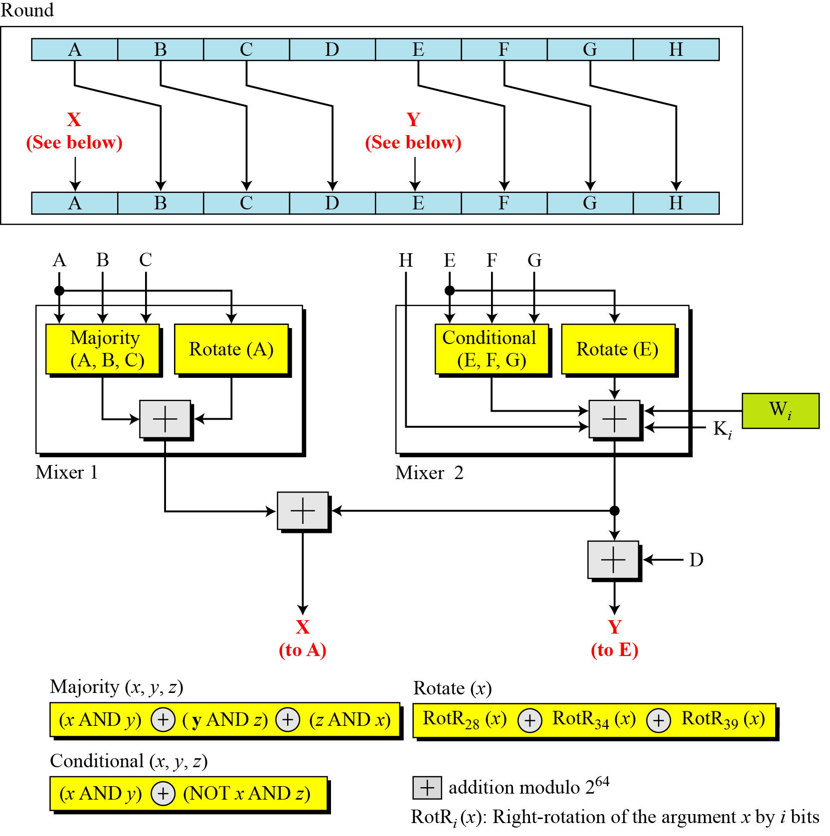
Structure of each round in SHA-512
Notes:
60

Slide 61

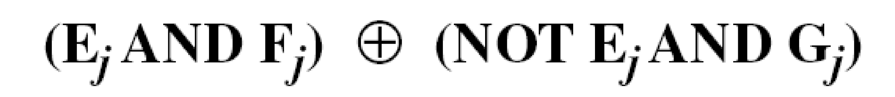
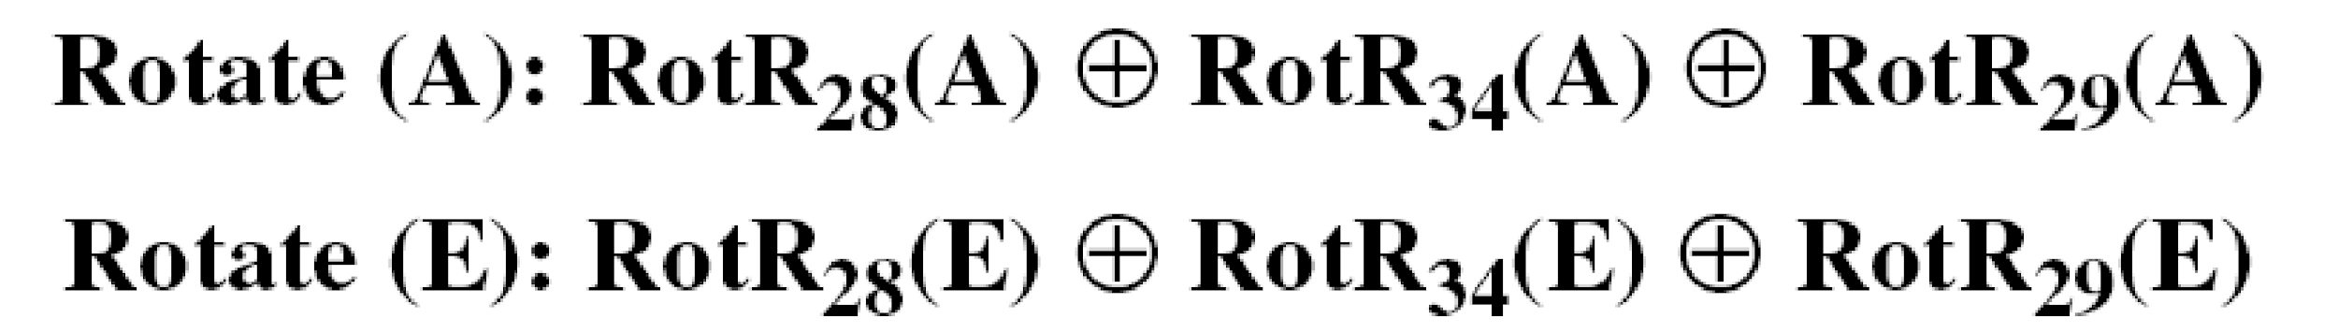
Majority Function
Conditional Function
Rotate Functions
Notes:
61

Slide 62
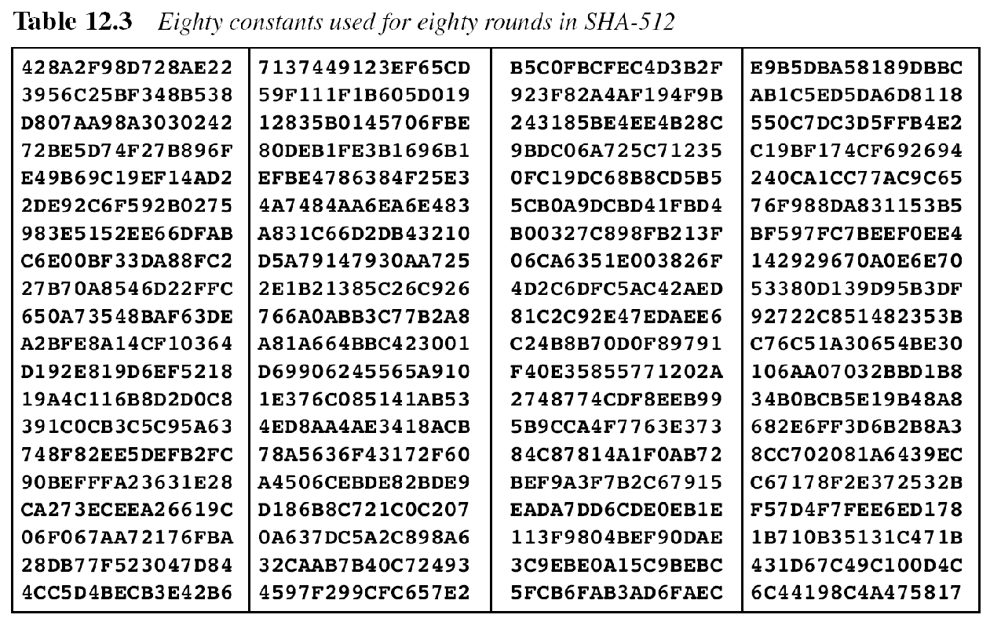
Notes:
62

Slide 63

There are 80 constants, K₀ to K₇₉, each of 64 bits. Similar These values are calculated from the first 80 prime numbers (2, 3,…, 409). For example, the 80th prime is 409, with the cubic root (409)^{1/3} = 7.42291412044. Converting this number to binary with only 64 bits in the fraction part, we get
The fraction part: (6C44198C4A475817)₁₆
Notes:
63

Slide 64
Example
We apply the Majority function on buffers A, B, and C. If the leftmost hexadecimal digits of these buffers are 0x7, 0xA, and 0xE, respectively, what is the leftmost digit of the result?
Solution
The digits in binary are 0111, 1010, and 1110.
a. The first bits are 0, 1, and 1. The majority is 1.
b. The second bits are 1, 0, and 1. The majority is 1.
c. The third bits are 1, 1, and 1. The majority is 1.
d. The fourth bits are 1, 0, and 0. The majority is 0.
The result is 1110, or 0xE in hexadecimal.
Notes:
64

Slide 65
Example
We apply the Conditional function on E, F, and G buffers. If the leftmost hexadecimal digits of these buffers are 0x9, 0xA, and 0xF respectively, what is the leftmost digit of the result?
Solution
The digits in binary are 1001, 1010, and 1111.
a. The first bits are 1, 1, and 1. The result is F₁, which is 1.
b. The second bits are 0, 0, and 1. The result is G₂, which is 1.
c. The third bits are 0, 1, and 1. The result is G₃, which is 1.
d. The fourth bits are 1, 0, and 1. The result is F₄, which is 0.
The result is 1110, or 0xE in hexadecimal.
Notes:
65

Slide 66
Analysis
With a message digest of 512 bits, SHA-512 expected to be resistant to all attacks, including collision attacks.
Notes:
66

